Slide 2
Chapter 1: Introduction
Part A: Core Concepts
Part B: The Practicalities
Rationale, Scope and Background of Cultural Risk Assessment and CIERA
Chapter 2:
Chapter 8:
Cultural Risk Assessment & The Cultural Inclusivity and Equity Risk Assessment (CIERA)
Chapter 3: Cultural Risk – EEDI and Bias
Activating Theory -
England and Wales Cricket Board
Chapter 9:
Chapter 4: The Science of Inclusion and Bias
Managing Organisational Risk: Integrating Cultural Risk Awareness into Corporate Governance
Chapter 10:
Chapter 5: Culture
Chapter 11:
Comparing faith in cultural contexts: In Sacred Spaces and on the Dancefloor
Chapter 6: Theories and Frameworks
Chapter 12:
Activating Theory - Action Research with Faith Leaders for the British Ritual Innovation in COVID
Chapter 7: Cultural Intelligence (CQ)
Chapter 13:
Between the lines -
Conversations in Context, a Dialogical Approach
Part C: Case Studies
CS 1: Sweden – Religious Heritage
CS 10: UK – Faith and Sexuality
CS 2: UK – Sensory Rooms
CS 6: Qatar – Football World Cup
CS 11: UK – Cultural Events
CS 3: England – Prom Events
CS 7: USA – NFL
CS 12: USA – Belonging and Ethnicity
CS 4: UAE – Cultural Awareness
CS 8: Japan – Cultural Heritage
CS 13: Caribbean – Diaspora Communities
CS 5: Australia – Indigenous Communities
CS 9: UK – Sport and Gender
CS 14: Nigeria – Business Events

Slide 3
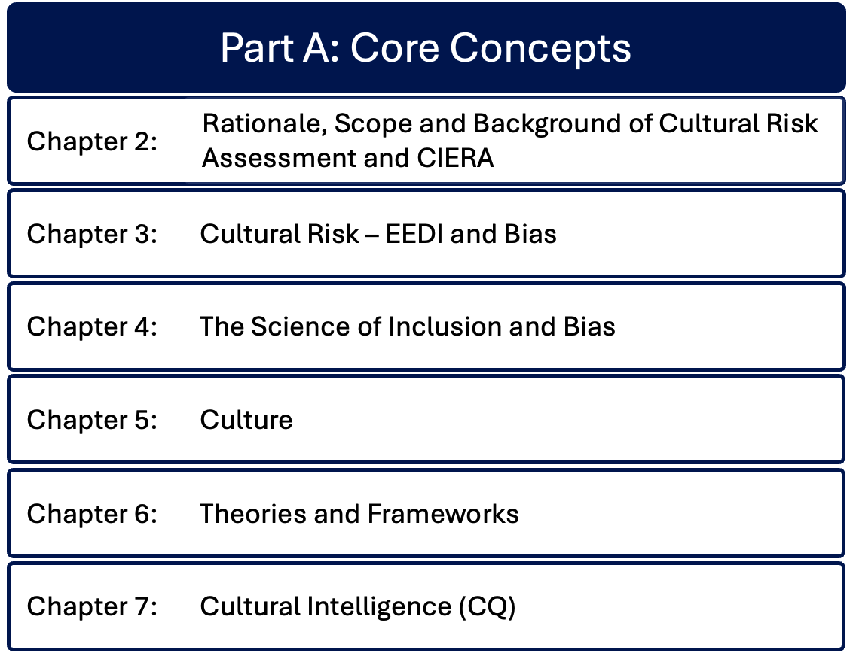

Slide 4
Chapter 4: The science of inclusion and inclusivity Bernadette Albert & Ruth Dowson
Historical and contemporary academic significance of inclusion, tracing the philosophical origins of inclusion to Plato and its resurgence in modern social policy to address inequalities and provide equal opportunities for all.
Emphasizes the importance of creating environments in which diversity is valued, and individuals feel respected and supported.
Theoretical frameworks: Social Identity Theory, Critical Race Theory, Intersectionality, Human Capital Theory, Post Colonial Theory.
Barriers to inclusivity: systemic, cultural and structural obstacles, the role of power dynamics and privilege in shaping inclusion.
Need for a nuanced approach to inclusivity, considering the complexities of intersectionality to create inclusive environments that celebrate diversity.

Slide 5
Overview of inclusion and inclusivity
Origins of social inclusion in Ancient Greek philosophy (Plato)
1970s-1980s reemerged and spread across Europe and North America
Social policies – state responsible for citizens, especially vulnerable
Welfare State attempted to reduce social inequalities, providing access to basic services
Social and economic safety nets created to promote ‘equal’ opportunities
Diversity regarded as advantageous
For events, inclusion means creating environments that enable individuals to feel valued, welcome, able to present authentically
Umbrella term – means of access, participation, achievement
Positive impacts of inclusion – active value of diversity

Slide 6
The social science of inclusion and inclusivity
Sociological theories discuss systemic barriers associated with power and privilege
Psychological theories of identity, belonging
Theories addressing historic systemic and structural impacts of exclusion
Cultural and contextual theories; complexities from defining characteristics
Social identity theory; Critical Race theory; Intersectionality; Human Capital theory; Postcolonial theory
Re-defining Inclusion and exclusivity, exclusion, othering

Slide 7
Intersectionality and its relevance to inclusivity
Complex identities encompassing multiple defining characteristics create unique circumstances
Impact on creating inclusive events and event spaces for participants including employees and service pr

Slide 8
Barriers to inclusivity
Power systems and Systemic barriers
Cultural barriers – lead to differing communication styles in:
  high and low context cultures;
  achievement vs ascription-oriented cultures;
  universalism vs particularism.
  Inclusion requires dominant cultures to practice cultural humility, identifying and mitigating cultural risk
Structural barriers – physical, systemic and organizational obstacles can embed or constrain inclusive participation

Slide 9
Power dynamics in cultural interactions and the impact on inclusion
Power relationships impact on individuals, organizations, and societal structures
Forms of power – Reward, Coercive, Legitimate, Referent
Determine voices heard, priorities, expert, change
Cultural hegemony – dominant groups normalise their values and cultural practices, embedding authority and influence
Hierarchies can suppress and marginalise lower levels
High/Low power distance cultures influence exclusion / inclusion
Equity requires engineering a level playing field

Slide 10
Privilege in cultural interactions and the impact on inclusion
Privilege is subtle yet profound, often covert
Provides an ‘invisible knapsack’ that gives unearned advantage to dominant groups – including education, employment, economic advantage
Undermines cultural identities and contributions
May lead to cultural imperialism – imposing values and practices
  E.g. English speaking; ‘Expat’ (expatriate) vs ‘Immigrant’

Slide 11
The relationship between cultural diversity and cultural risk management in events
Diversity enriches through innovation and wider global appeal
Adds complexity in planing events and managing event spaces
  Cultural insensitivities
  Operational issues
  Misaligned expectations
Mitigate conflicts by assessing cultural risk across the event cycle

Slide 12
Summary
Overview of inclusion, philosophical origins
Justifies relevance of inclusion in creating event environments that value diversity
Explains relevance of key theoretical frameworks
Identifies barriers and complexities
Lays foundations for the Cultural Risk Assessment as a strategic tool in the event management process

Slide 13
Discussion questions
How can an appreciation of inclusion and cultural diversity enable event managers to effectively incorporate diverse cultural perspectives into the planning and execution of events to ensure inclusivity and equity?
What concepts discussed here can enable event and venue managers to develop strategies to identify and mitigate cultural risks, such as misunderstandings or conflicts, while fostering a sense of belonging for all participants?
In what ways do power dynamics and privilege manifest in event management, and how can leaders address these issues to create more equitable environments for attendees and staff?
From this chapter, what key structural barriers to inclusion in the events industry can you identify, and how can event organizations approach the redesign of their policies and practices to overcome these obstacles?
How can inclusive leadership enhance cultural risk management in event settings, and what specific leadership traits are most critical in fostering inclusivity?
How can event managers incorporate an intersectional approach to ensure that overlapping identities, such as race, gender, and disability, are considered in event planning and delivery?
What metrics or feedback mechanisms can organizers use to evaluate the success of inclusion initiatives and refine their strategies for future events?

